Slide 1
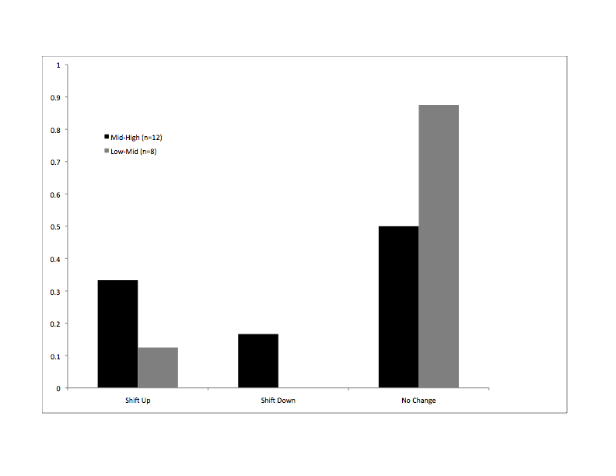
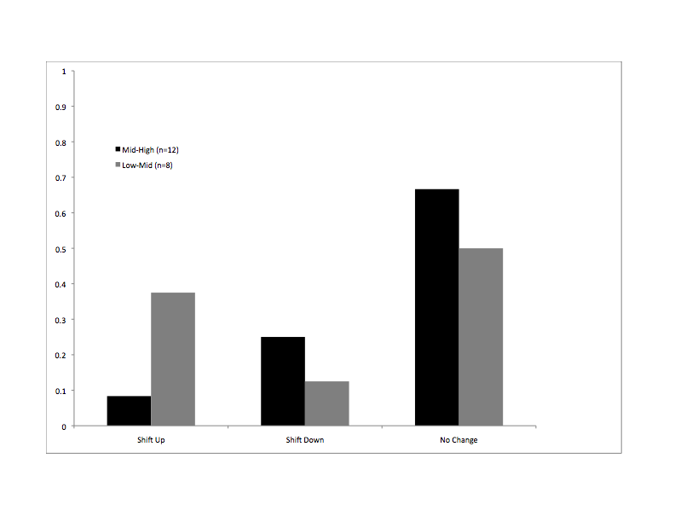
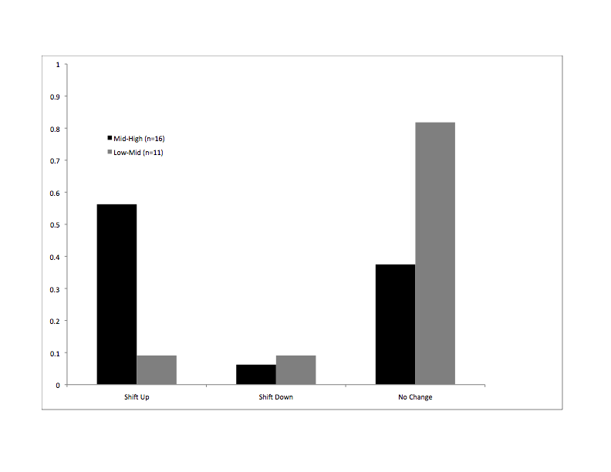
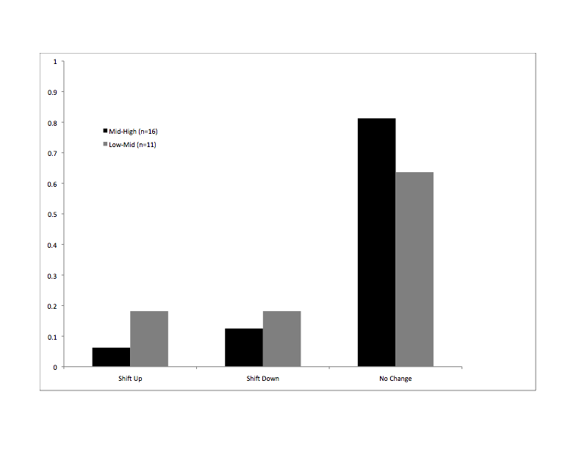
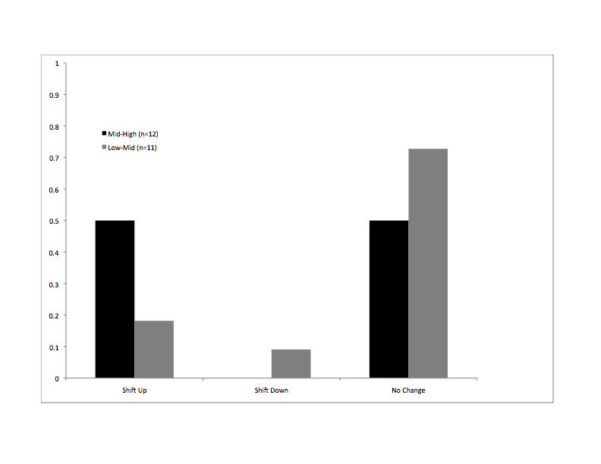
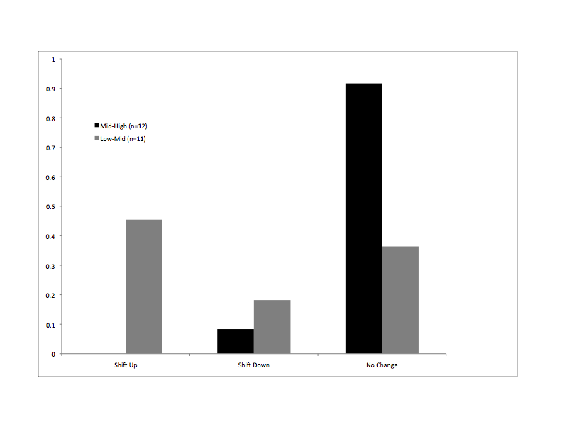
Summary of shifts for SN mammals
High sp
Low sp
Lower limits
Upper limits
Lassen
*
*
Yosemite
*
*
*
Sequoia
shift up
shift dn
stable
shift up
shift dn
stable

